Slide 1
Pilot simulation
GEBC of Voronoi vertices
Subnetwork of about 3800 Voronoi vertices, centered at (0,0).
Runtime was about 4 hours on 20 cores (pilgrim).
r = 30

Slide 2
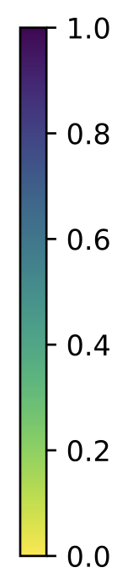
Pilot simulation
GEBC of Voronoi vertices: subnetworks of various radii
r = 18
r = 20
r = 22
r = 24
r = 26
r = 28
r = 30
r = 32

Slide 3
Pilot simulation
GEBC of Voronoi vertices: code performance
Radius | Number of vertices | Runtime on Pilgrim (20 cores) (hours)
32 | 4347 | 17.60
30 | 3813 | 4.00
28 | 3328 | 2.47
26 | 2873 | 1.12
24 | 2446 | 0.45 (27 min)
22 | 2056 | 0.18 (11 min)
20 | 1700 | 0.08 (5 min)
18 | 1379 | 0.07 (4 min)

Slide 4
Size of analyzed subclusters
Sim. 3 |  | Sim. 4
Radius | Num. of vertices | Radius | Num. of vertices
37 | 4414 | 28 | 4563
35 | 3947 | 26 | 3944
32 | 3274 | 24 | 3342
30 | 2881 | 22 | 2807
28 | 2314 | 20 | 2320
24 | 1816 | 18 | 1867

Slide 5
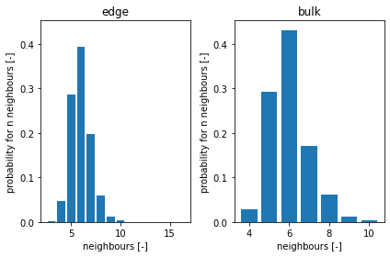
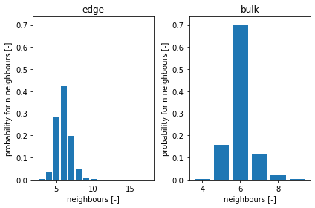
Comparison of normalized GEBC values between two different distributions of neighbors
simulation 3
# Voronoi nodes = 1816
radius = 24
2314
28
2881
30
# Voronoi nodes = 1867
radius = 18
2320
20
2807
22
simulation 4

Slide 6
Comparison of normalized GEBC values between two different distributions of neighbors
simulation 3
# Voronoi nodes = 3274
radius = 32
3947
35
4414
37
# Voronoi nodes = 3342
radius = 24
3944
26
4563
28
simulation 4

Slide 7
Comparison of unnormalized GEBC values between two different distributions of neighbors
# Voronoi nodes = 1816
radius = 24
2314
28
2881
30
simulation 3
# Voronoi nodes = 1867
radius = 18
2320
20
2807
22
simulation 4

Slide 8
Comparison of unnormalized GEBC values between two different distributions of neighbors
# Voronoi nodes = 3274
radius = 32
3947
35
4414
37
simulation 3
# Voronoi nodes = 3342
radius = 24
3944
26
4563
28
simulation 4

